Slide 1
Blinking-Based Multiplexing Imaging Using Squaraine Dyes
September 6
Kirill Kniazev

Slide 2
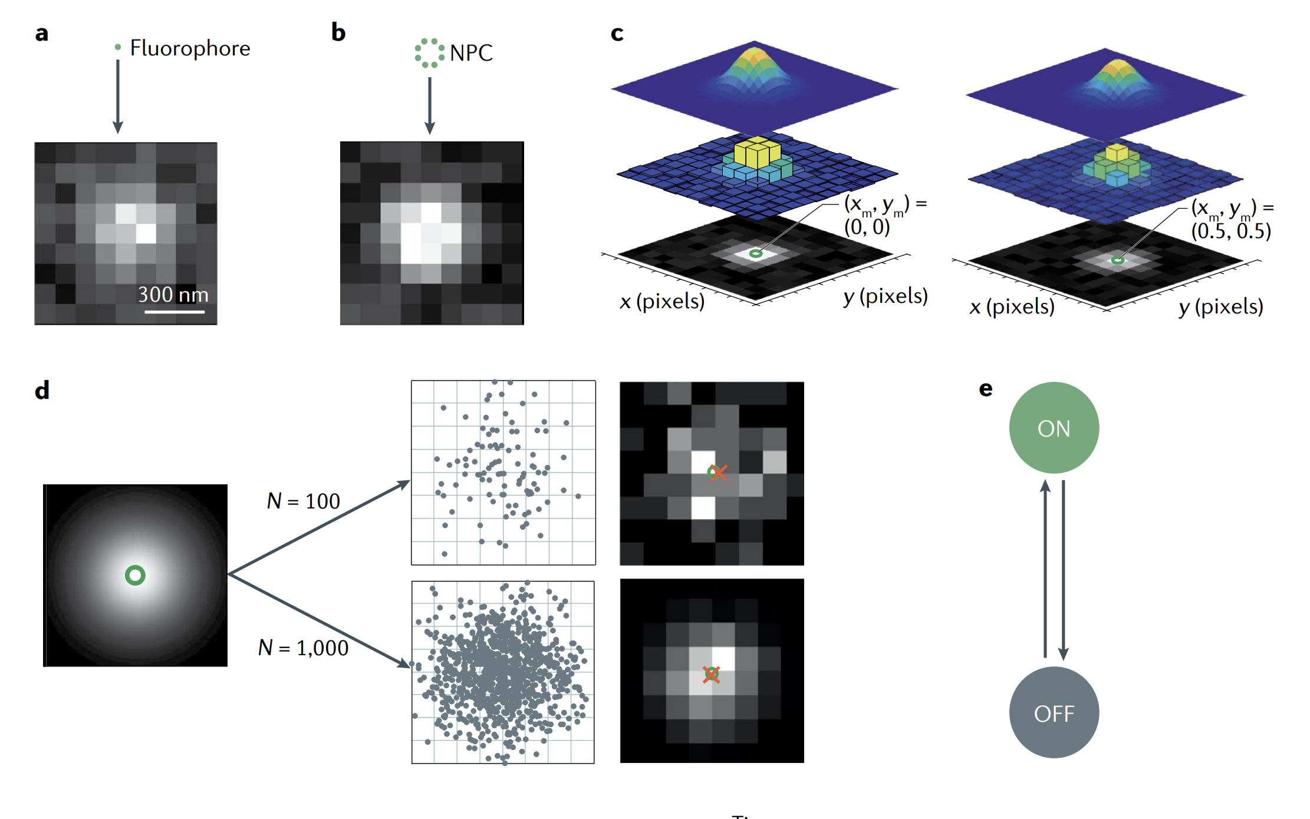
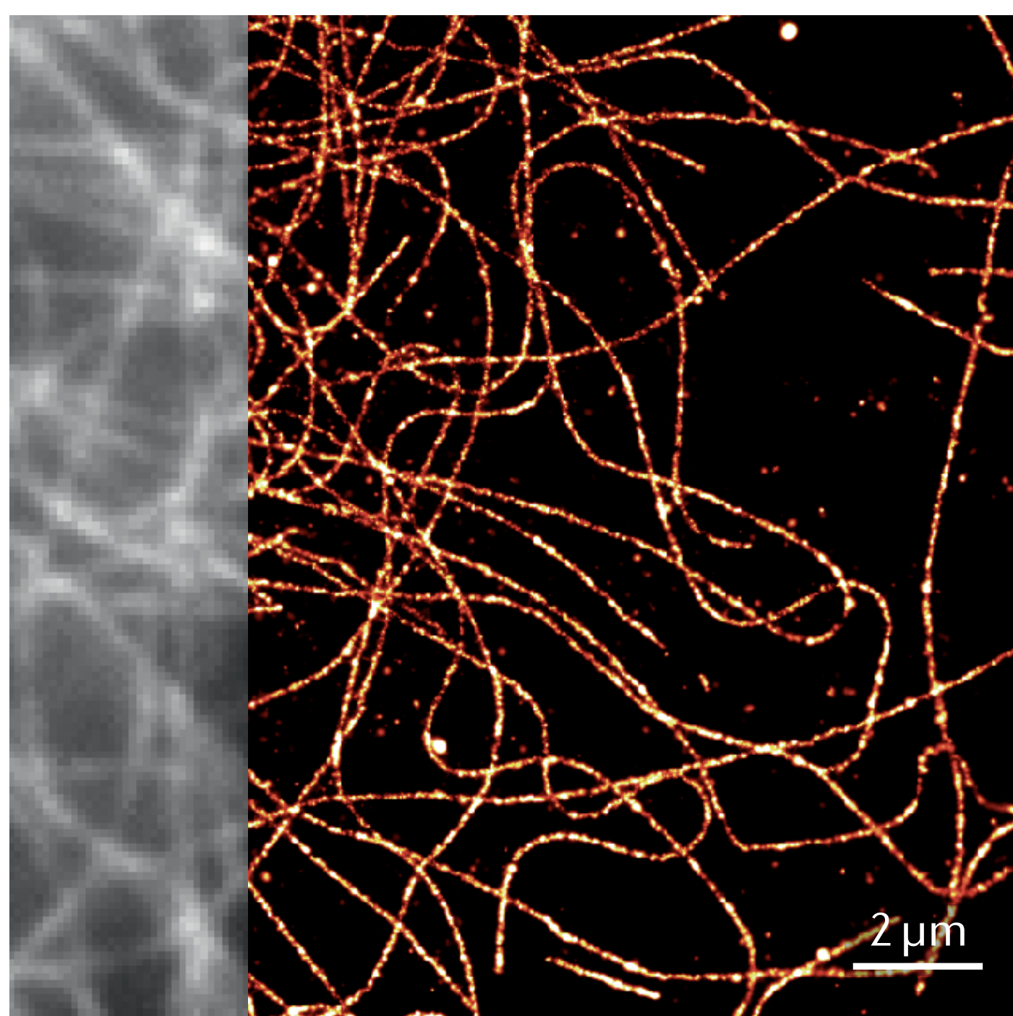
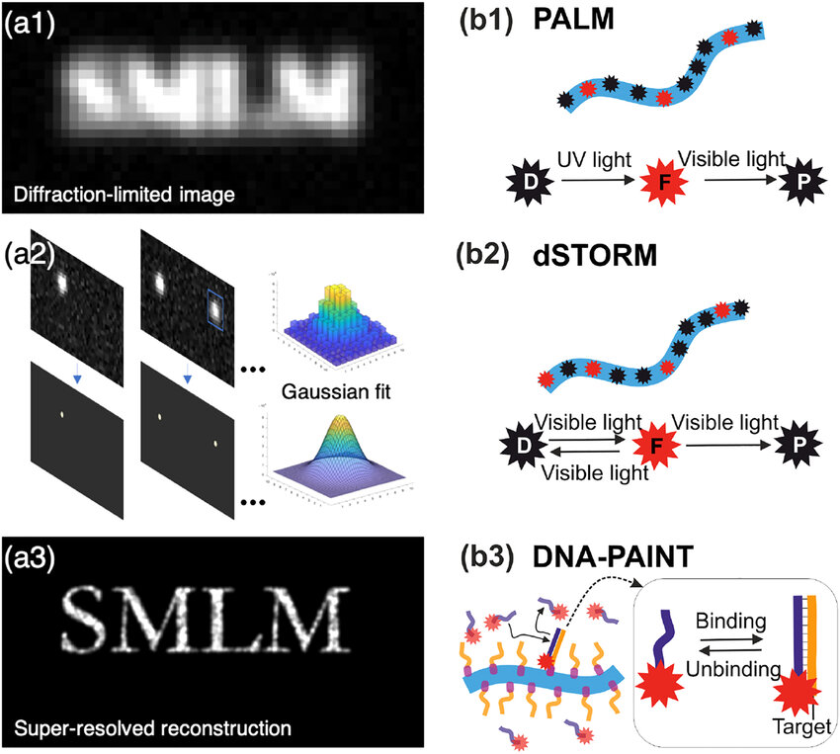
Introduction
Example of Fluorescence imaging and
Single Molecule Localized Microscopy Image
Notes:
Kniazev, K.; Guo, T.; Zhai, C.; et. al.; Single-molecule characterization of a bright and photostable deep-red fluorescent squaraine-figure-eight (SF8) dye. Dyes and Pigments. 2023. 210. 111031.

Slide 3
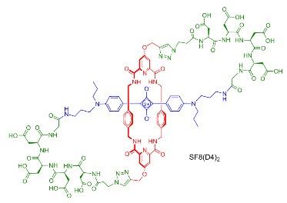
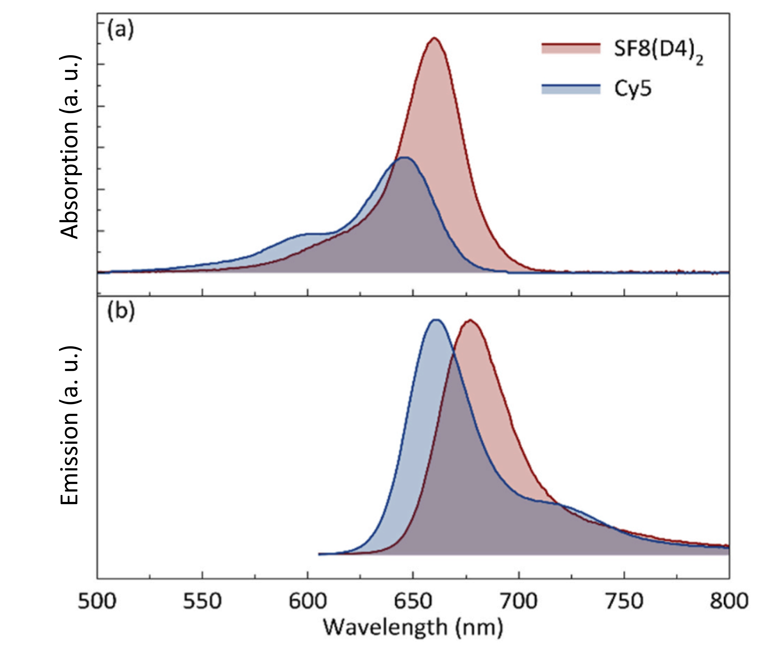
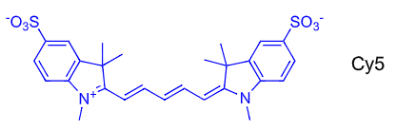
Introduction to Dyes
Dyes Absorption and Emission
Absorption (a) and Emission (b) spectra of SF8(D4)2 and Cy5 in H2O.
Structures and SF8(D4)₂ and Cy5 dyes
Absorption window: 610 - 680 nm
Emission window: 640 - 710 nm
Notes:
Kniazev, K.; Guo, T.; Zhai, C.; et. al.; Single-molecule characterization of a bright and photostable deep-red fluorescent squaraine-figure-eight (SF8) dye. Dyes and Pigments. 2023. 210. 111031.

Slide 4
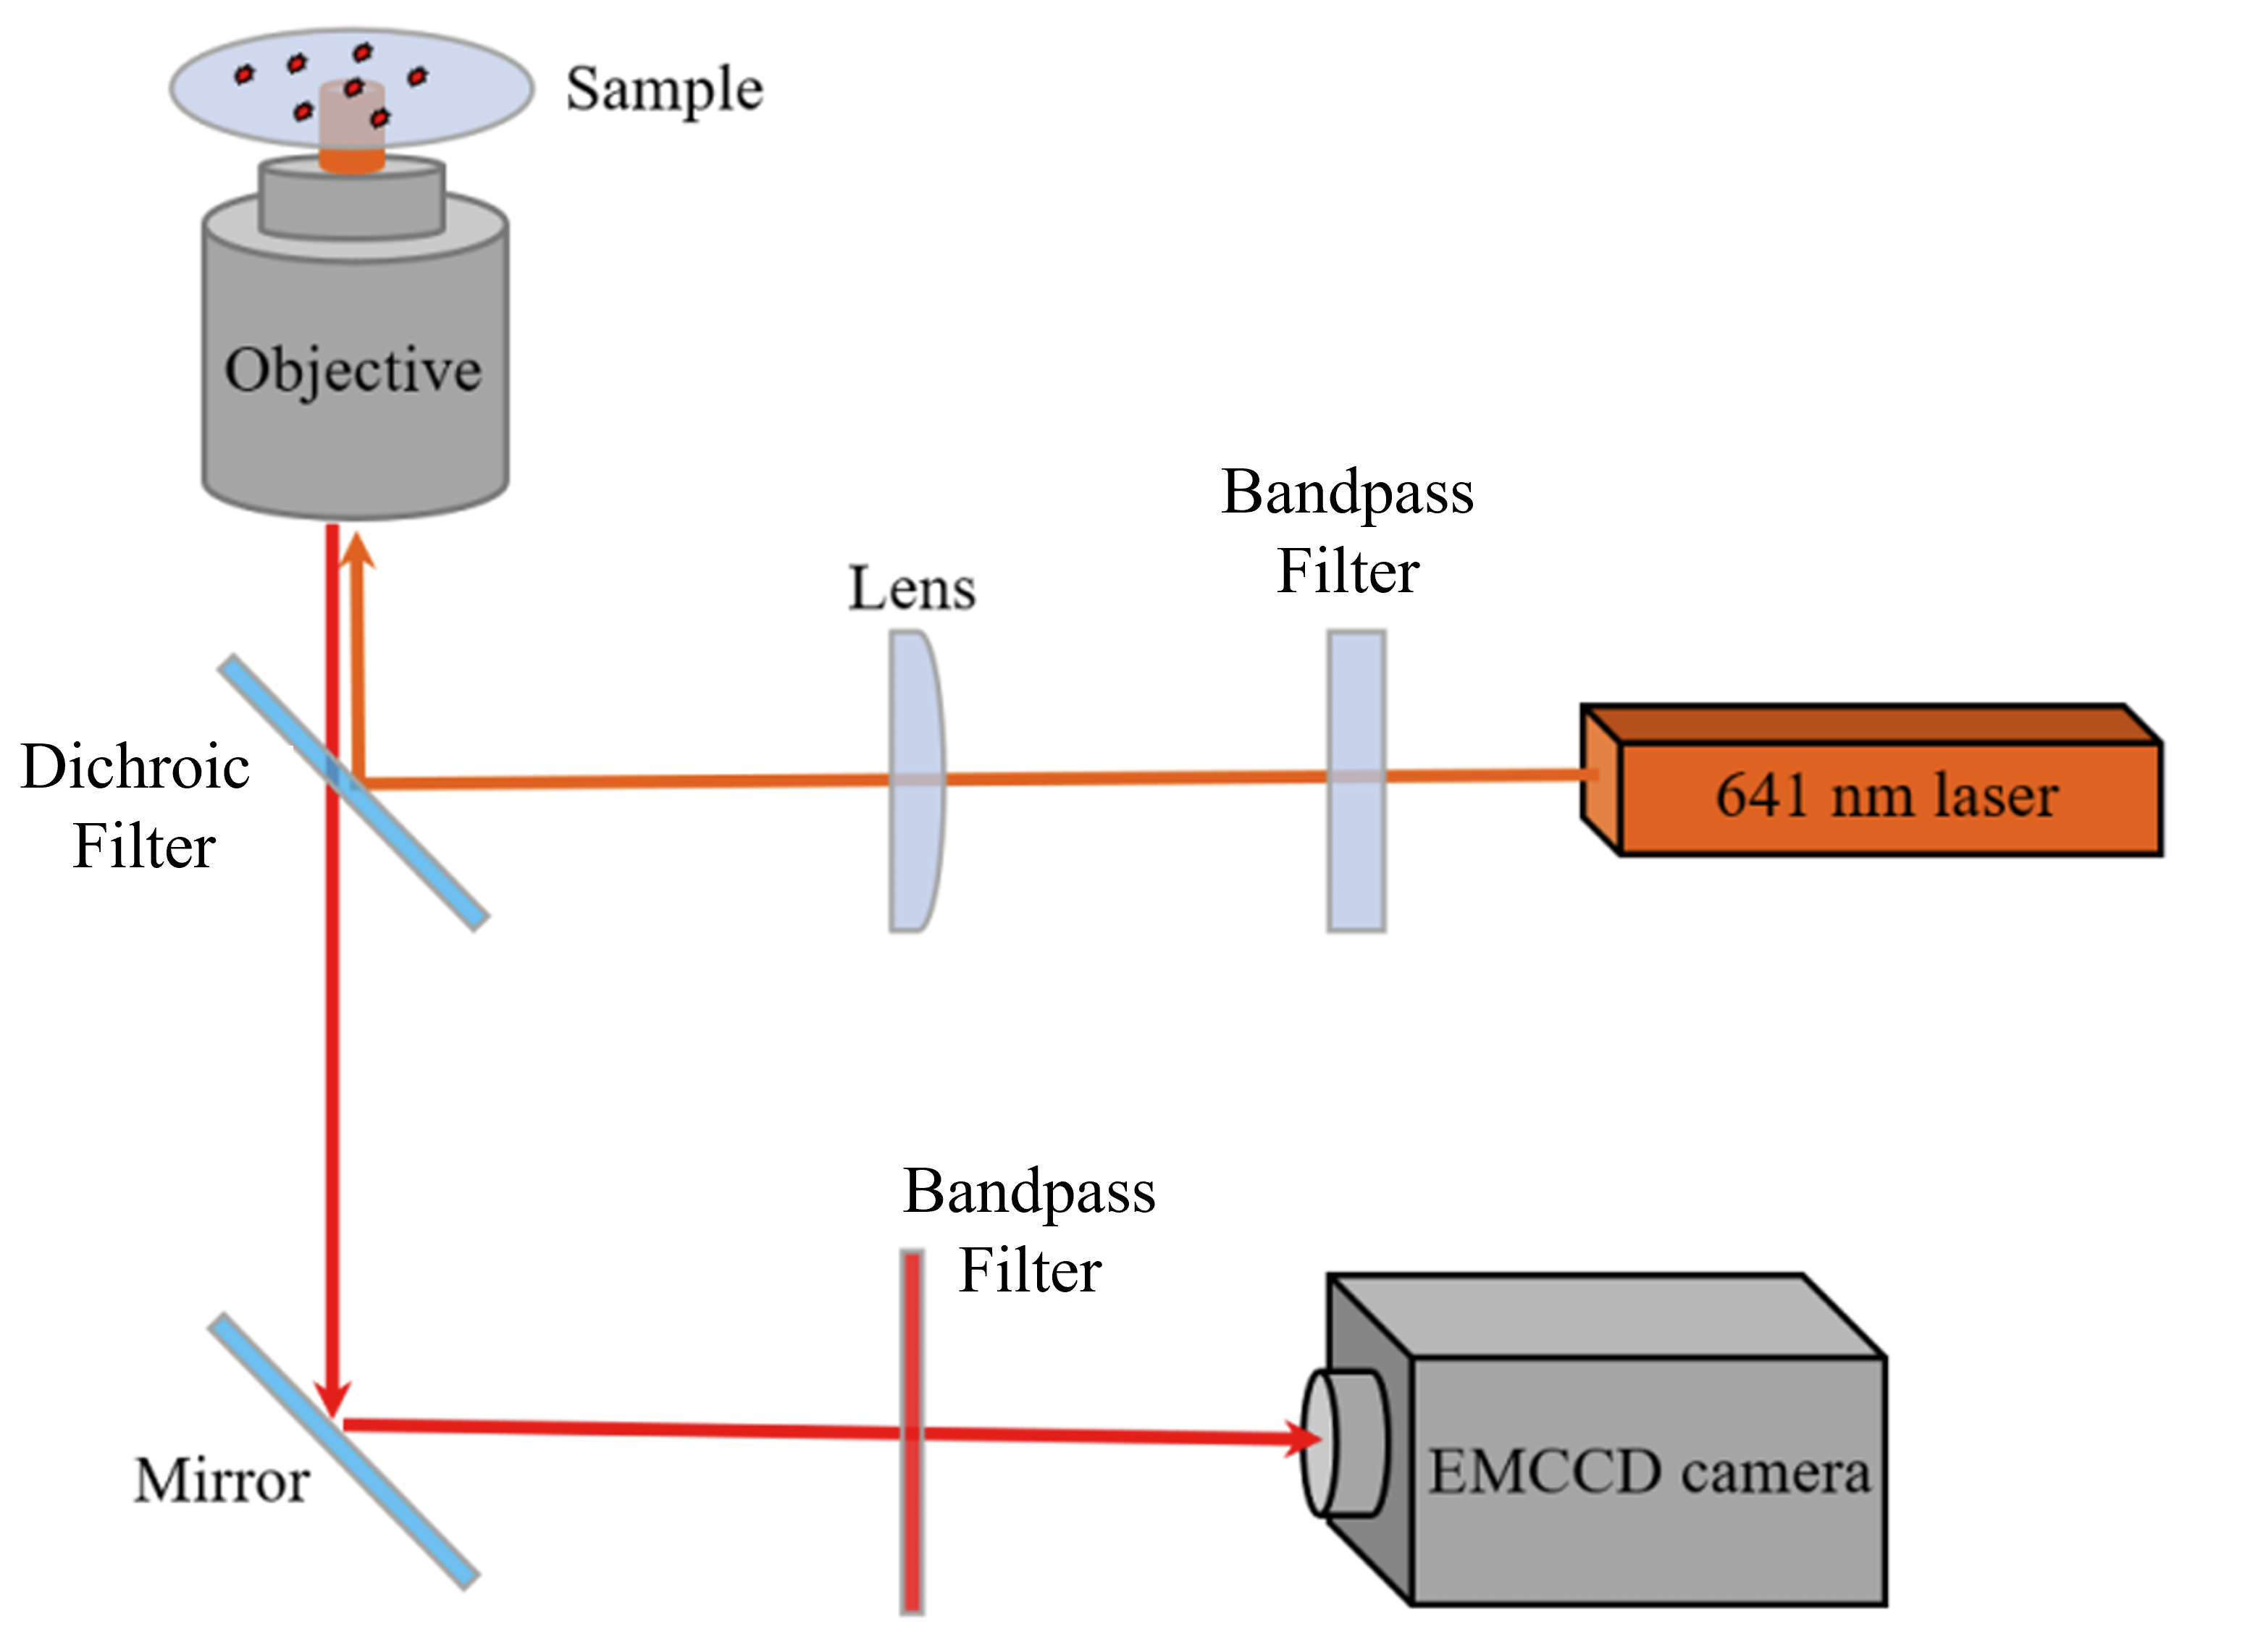
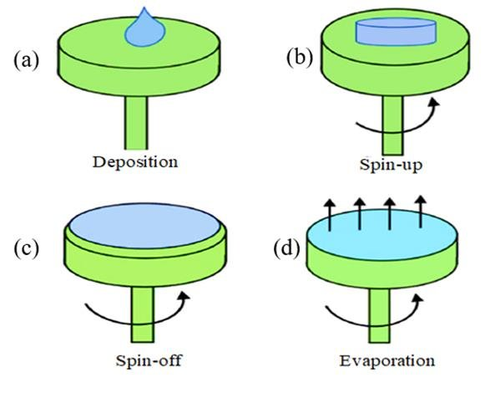
Experimental Setup with Sample Preparation
TIRF Microscope
Spin coating process
Experimental Set up
Accelerating and Slow down: 1 second
Spinning: 60 seconds
Rotations Per Minute: 2000
Notes:
Kniazev, K.; Guo, T.; Zhai, C.; et. al.; Single-molecule characterization of a bright and photostable deep-red fluorescent squaraine-figure-eight (SF8) dye. Dyes and Pigments. 2023. 210. 111031.
“Modeling and the main stages of spin coating process: A review”, JASTT, vol. 2, no. 02, pp. 119–123, Aug. 2021, doi: 10.38094/jastt203109.

Slide 5
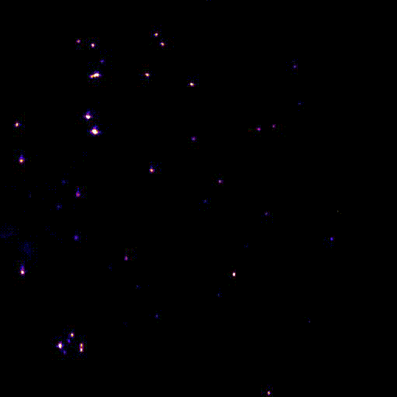
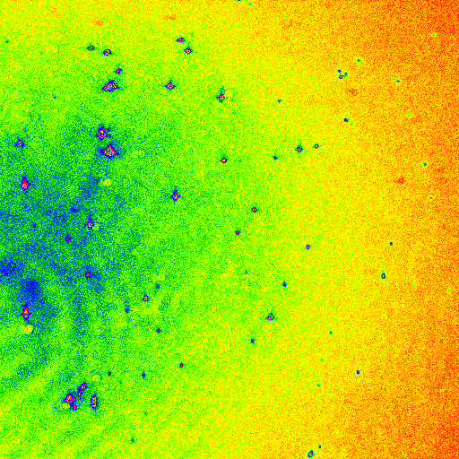
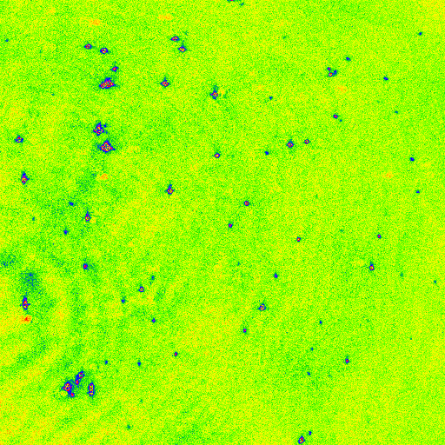
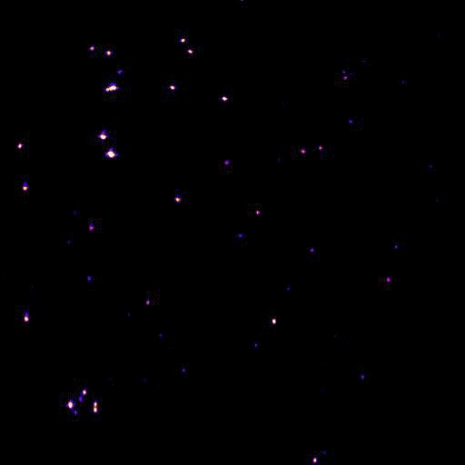
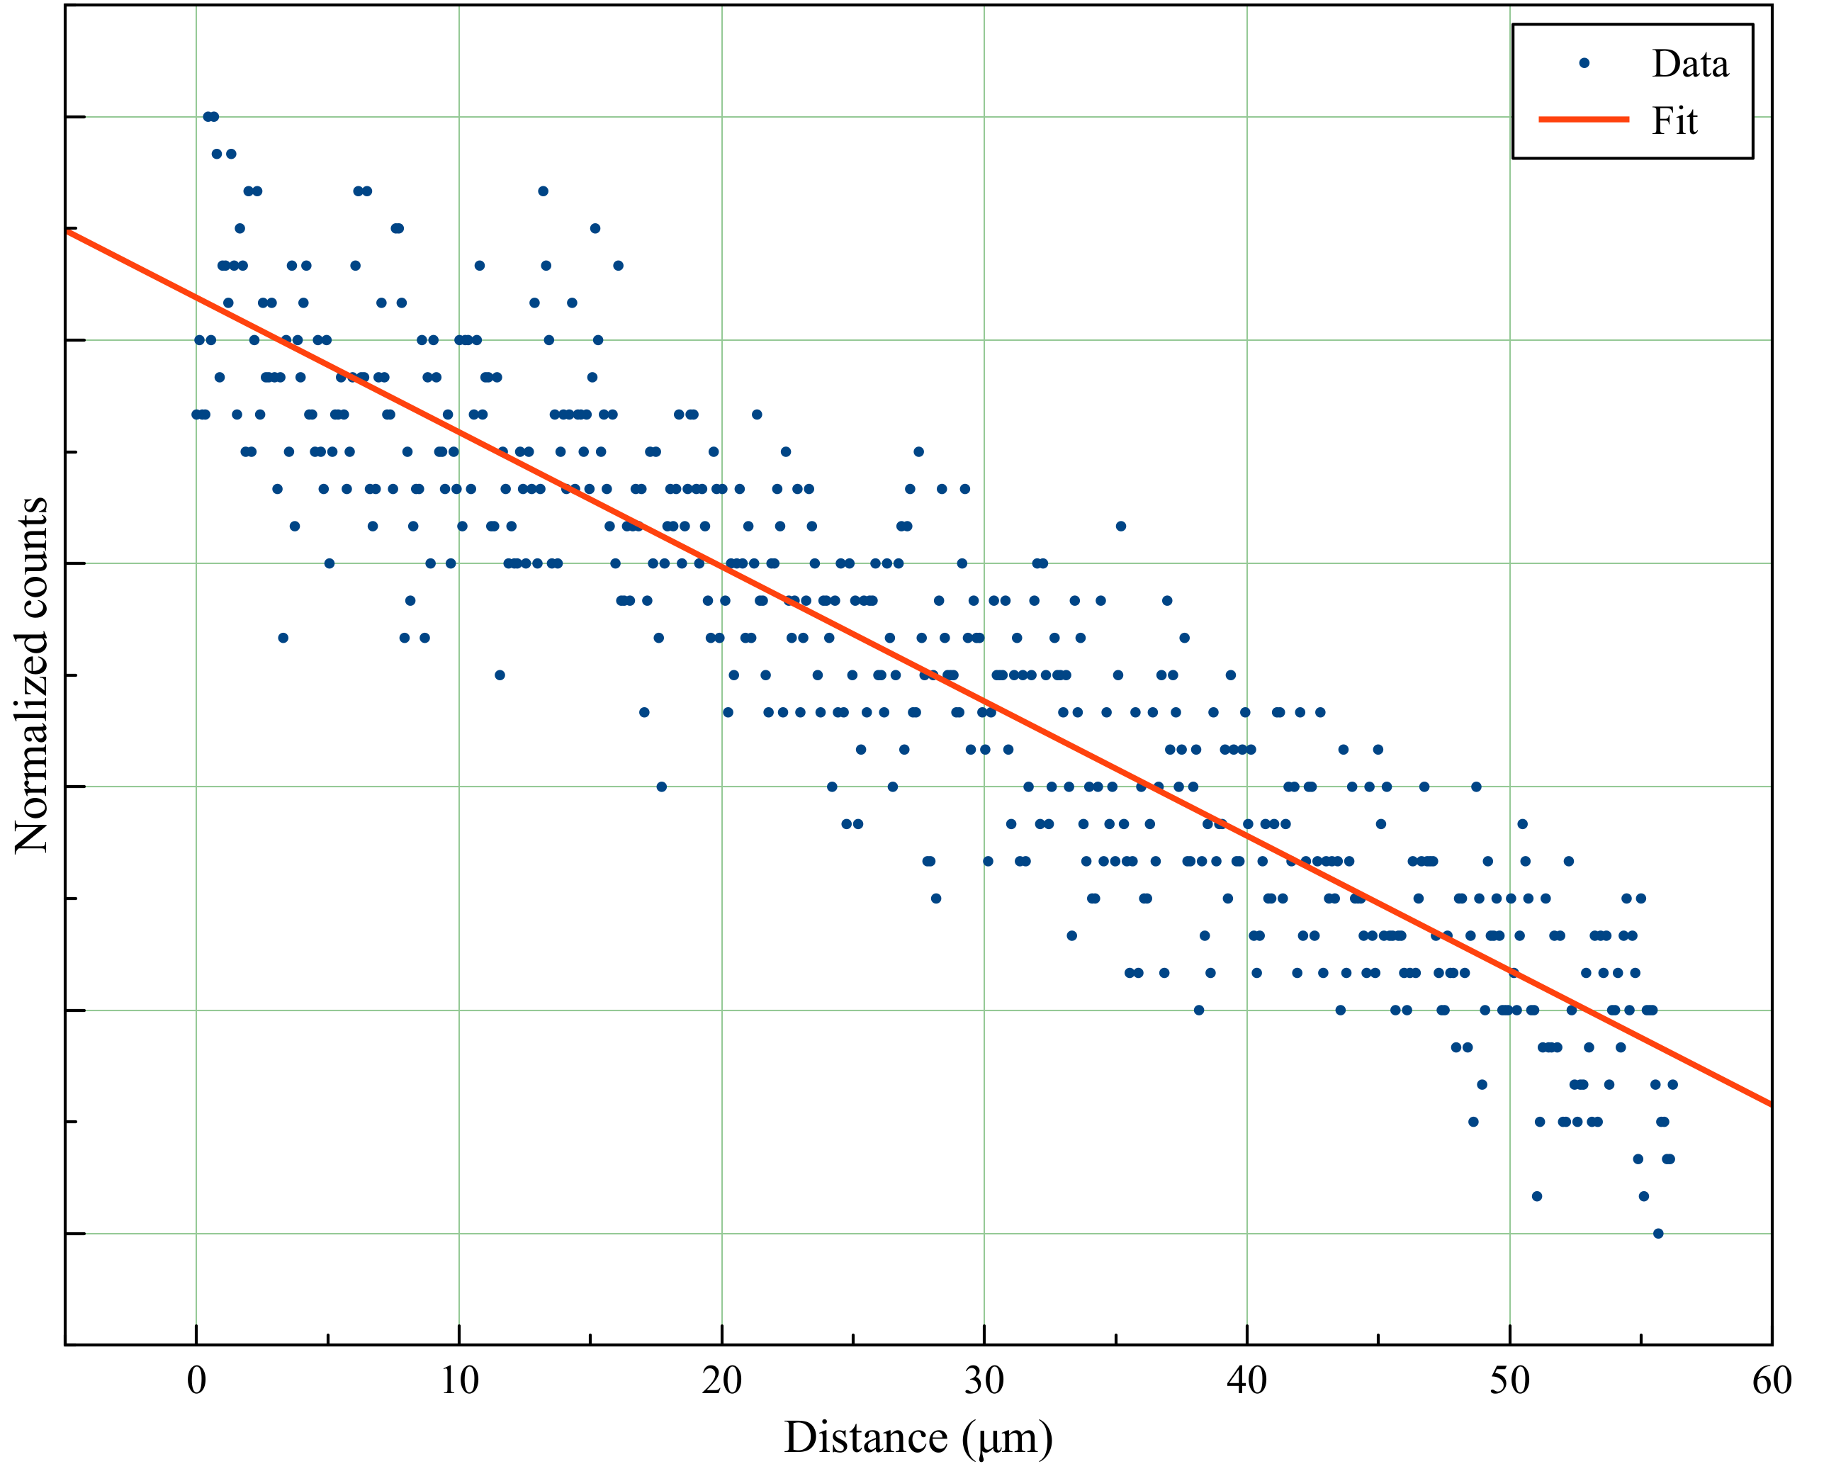
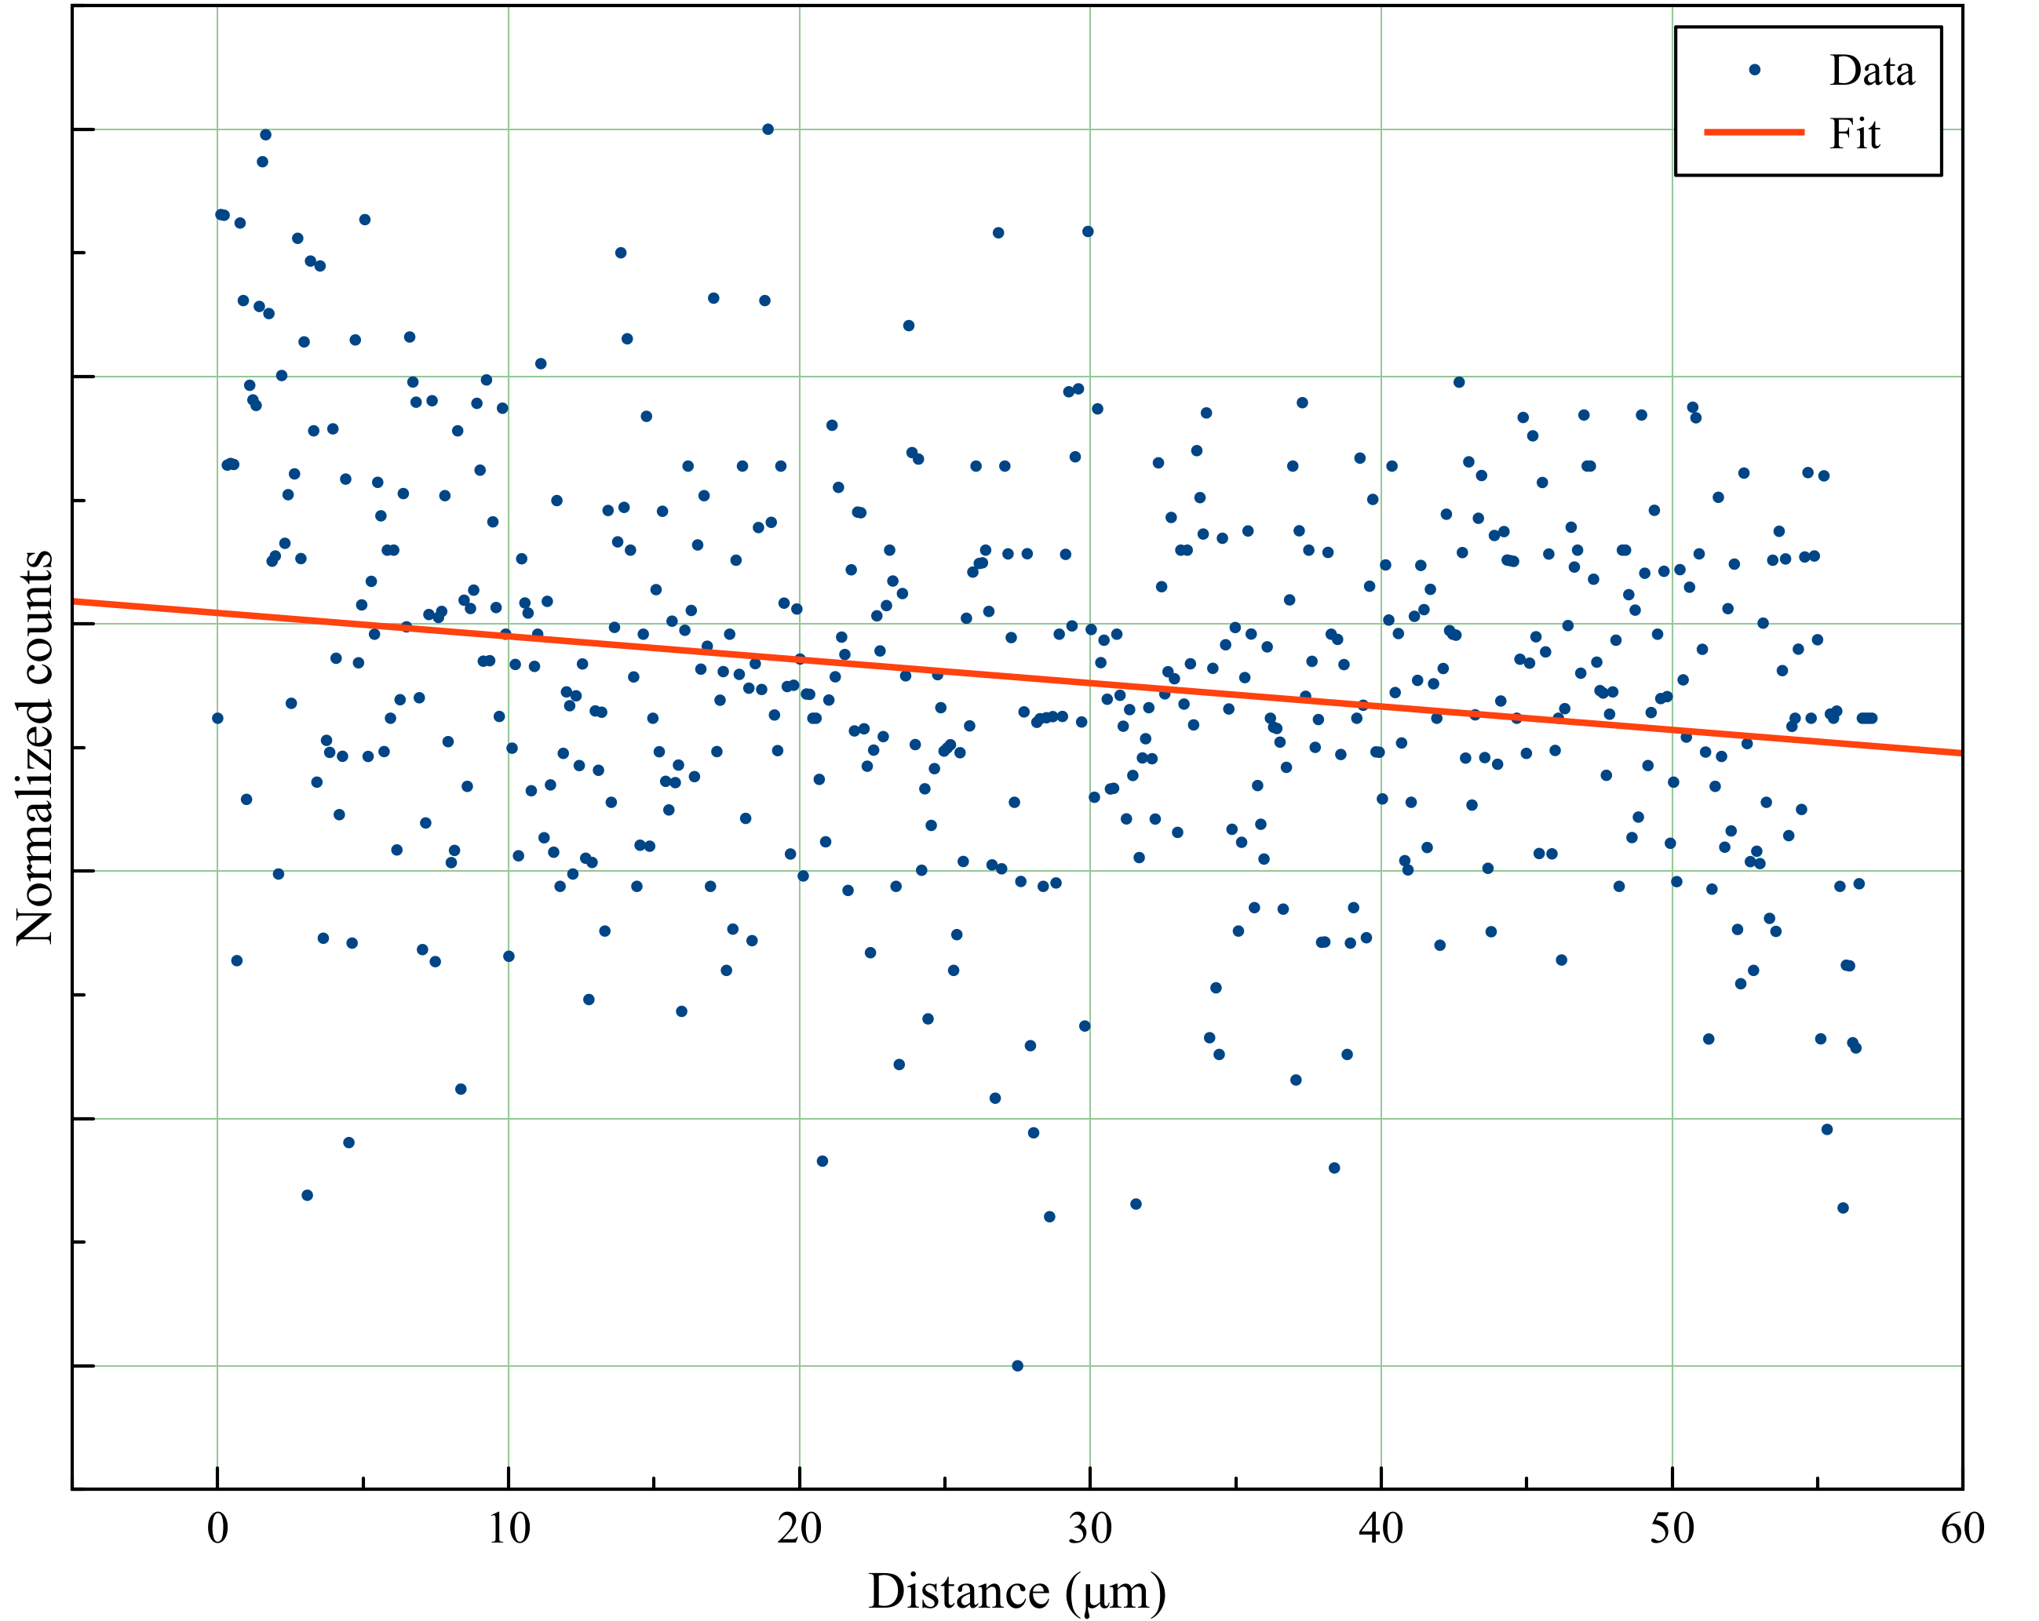
Data Processing - Denoising
Original
Denoised
1st frame @ high contrast
1st frame @ high contrast
Original Movie
Denoised Movie
Cy5 at 20 W/cm²
fit = kx+b
Representative TIRF movie
Simplifies thresholding and thus particles detection
k = 0.012
k = 0.002

Slide 6
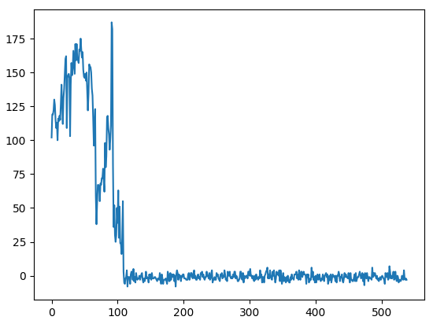
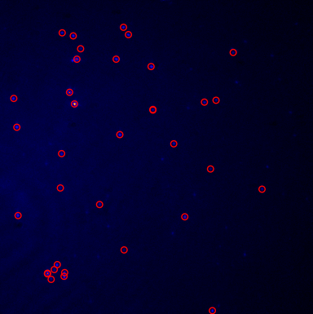
Data Processing – Particles Tracking
Goodson Lab:
First frame of the movie
Zoom in
Represented trace of the detected particle

Slide 7
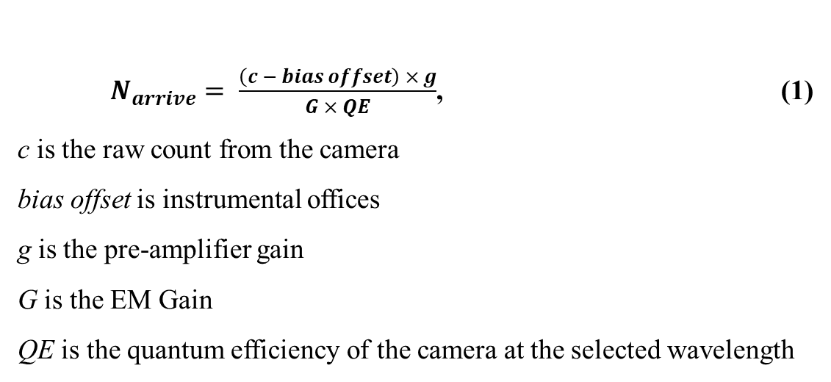
Received Photons
$N_{arrive}= \frac{\left(c − bias offset\right) × g}{G × QE}$, (1)
c is the raw count from the camera
bias offset is instrumental offices
g is the pre-amplifier gain
G is the EM Gain
QE is the quantum efficiency of the camera at the selected wavelength
Goodson Lab:

Slide 8
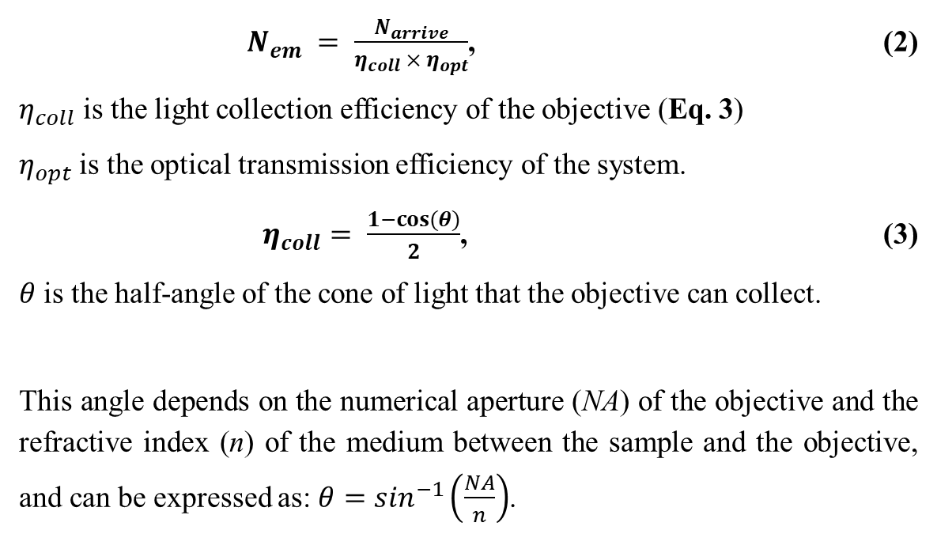
Emitted Photons
Goodson Lab:
$N_{em} = \frac{N_{arrive}}{η_{coll} × η_{opt}}$, (2)
$η_{coll}$ is the light collection efficiency of the objective (Eq. 3)
$η_{opt}$ is the optical transmission efficiency of the system.
$η_{coll}= \frac{1−cos⁡(θ)}{2}$, (3)
$θ$ is the half-angle of the cone of light that the objective can collect.
This angle depends on the numerical aperture (NA) of the objective and the refractive index (n) of the medium between the sample and the objective, and can be expressed as: $θ=\sin^{−1}\left(\frac{NA}{n}\right)$.

Slide 9
Demo
Performed on SF8(D4)₂ and 140 W/cm² illumination
Notes:
Kniazev, K.; Guo, T.; Zhai, C.; et. al.; Single-molecule characterization of a bright and photostable deep-red fluorescent squaraine-figure-eight (SF8) dye. Dyes and Pigments. 2023. 210. 111031.
“Modeling and the main stages of spin coating process: A review”, JASTT, vol. 2, no. 02, pp. 119–123, Aug. 2021, doi: 10.38094/jastt203109.

Slide 10
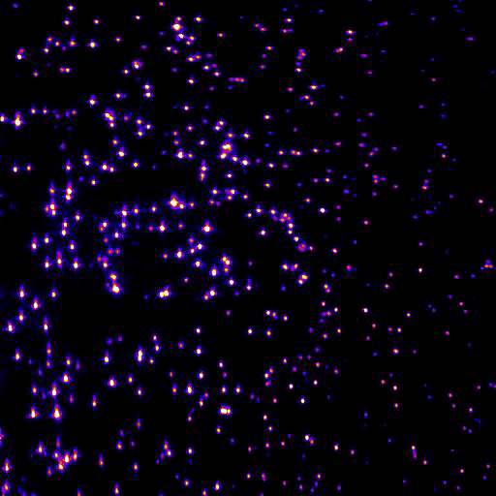
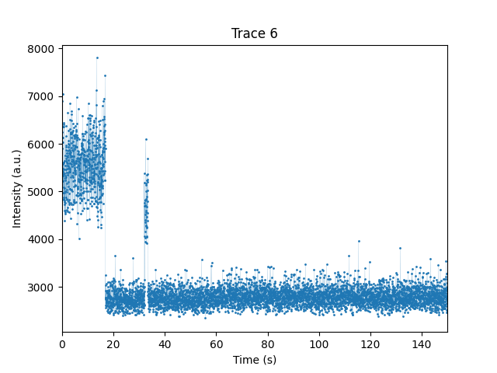
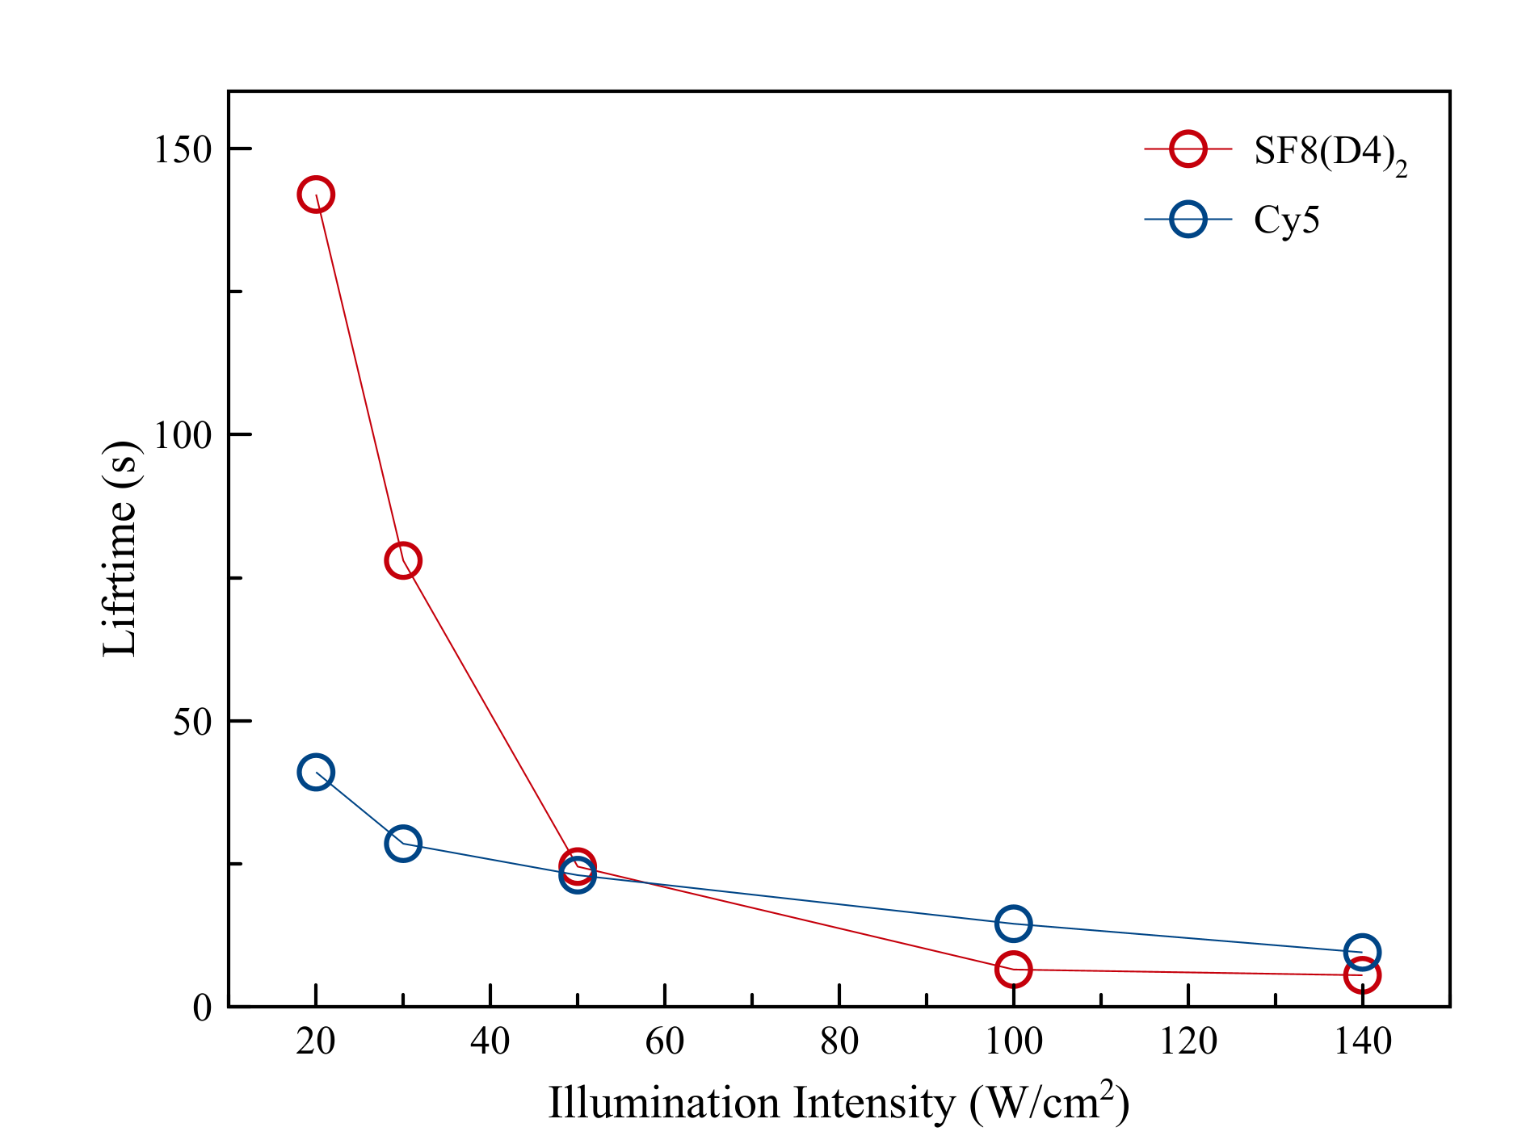
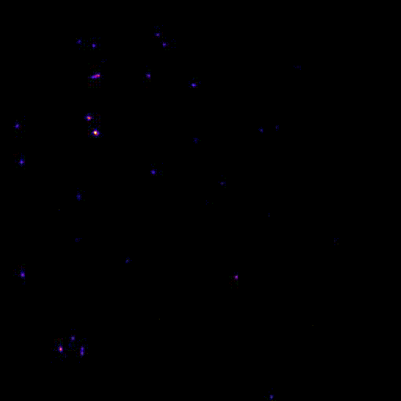
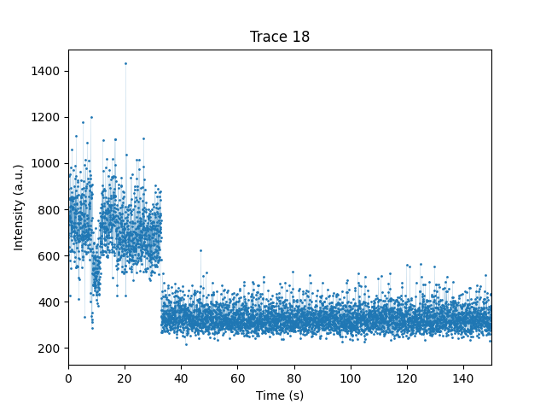
Current results – Dyes Characteristics
SF8(D4)₂
Cy5
Particles average life time
Andor integration time – 9 ms with 2ms interval;
Total movie time 5 min;
Movies are speed up
Representative Traces

Slide 11
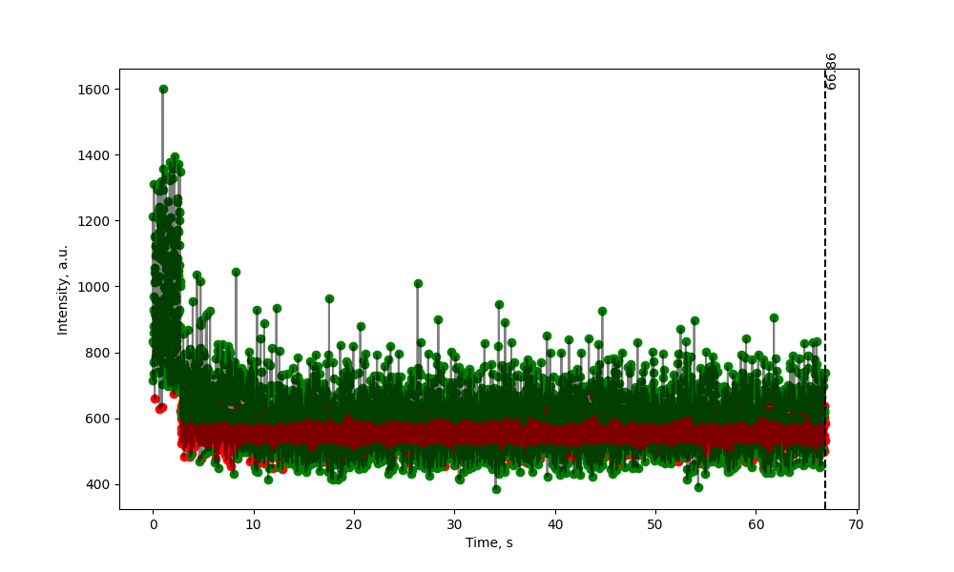
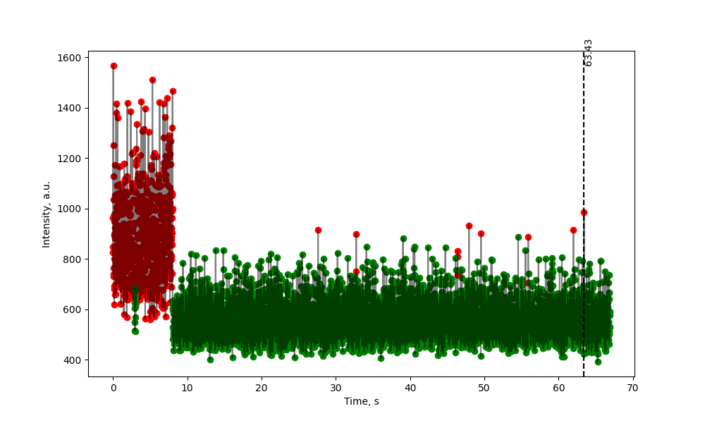
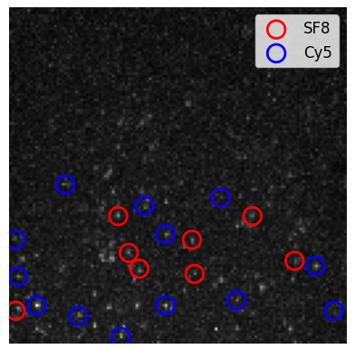
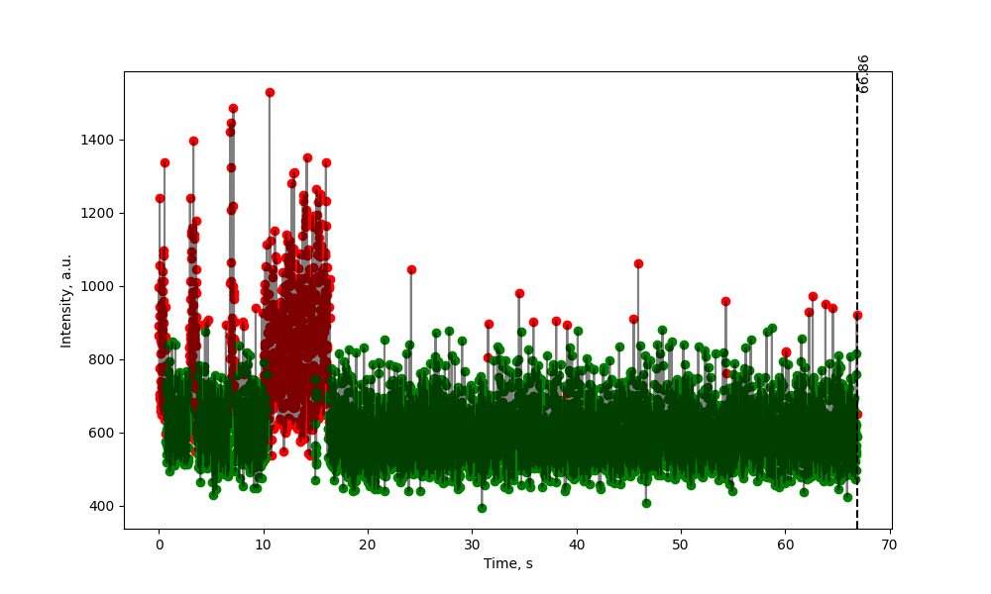
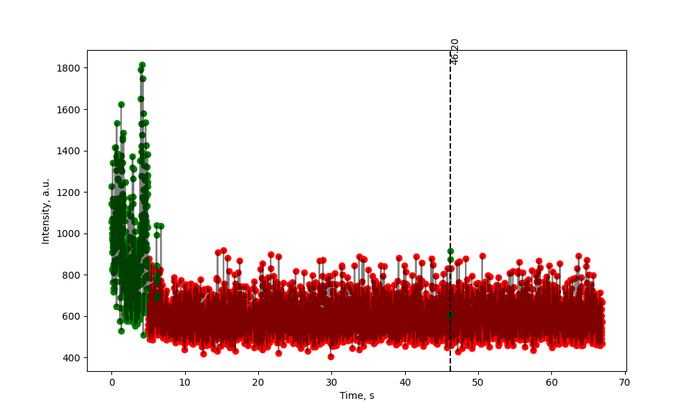
Current results – BBM Proof
Representative SF8 intensities
Maximum Projection with labeled SF8 and Cy5 particles
Representative Cy5 intensities
Notes:
SF8: 112
Cy5: 110,115

Slide 12
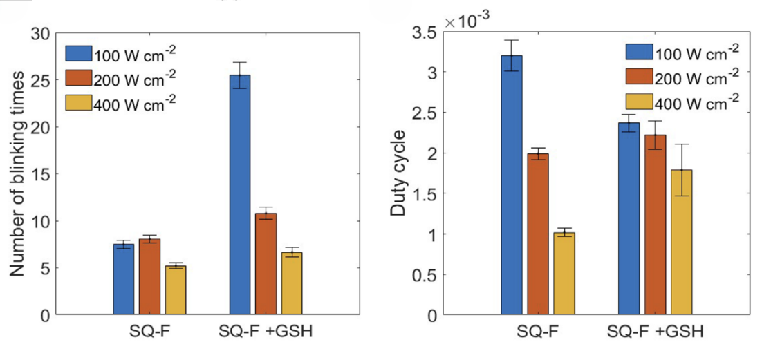
Future – Better blinking characterization
Number of blinking times (a) and duty cycles (b) of dye under different illumination intensities

Slide 13
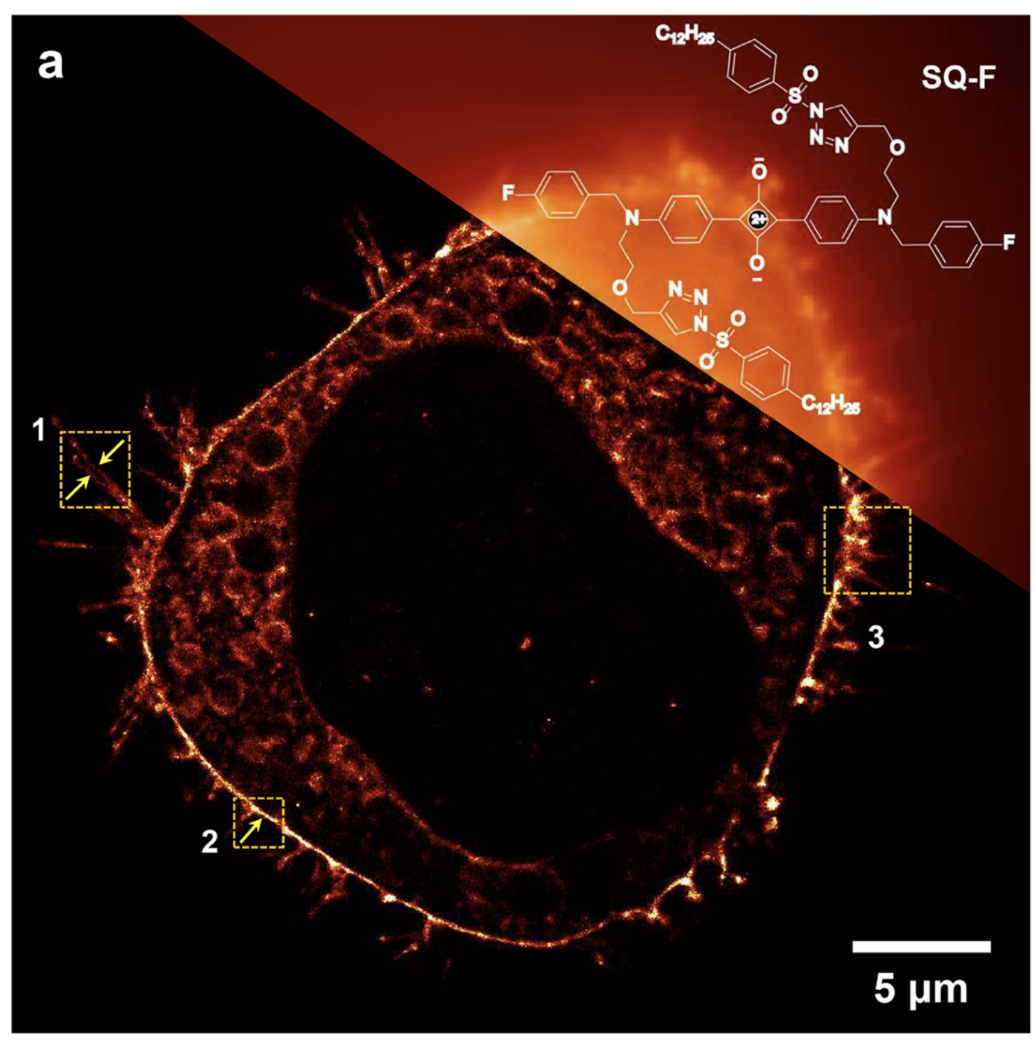
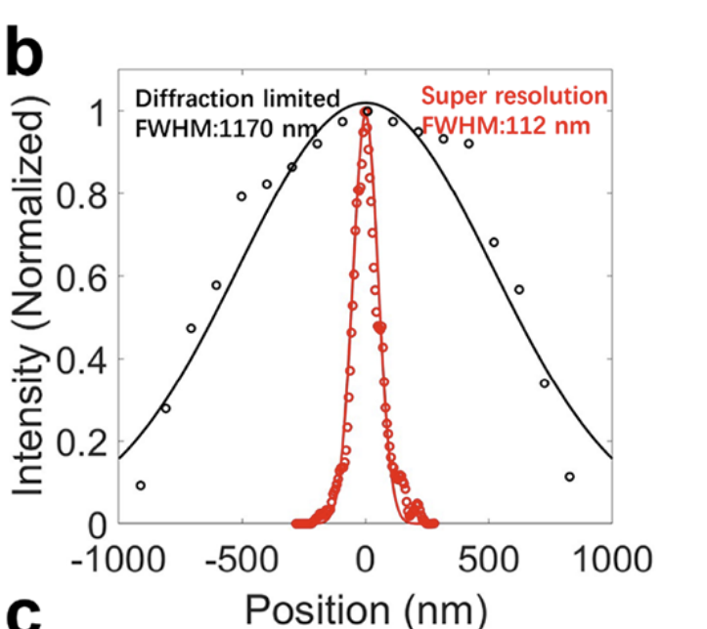
Future – Cell Imaging
Diffraction limited and super-resolution image of the cell
Image resolution characterization

Slide 14
Thank you!

